Slide 1
2024 Panther Lake CRD_OEM Summary Report
Stop
Customers confidential information under NDA, Intel internal use only
Rev1.0, CQ&R CMEE Team, 2024Q3

Slide 2
Objectives
Share Findings From CMEE Mobile Industry Data Collection (Panther Lake Platform Customer Survey)
Data Collected From 7 OEM Customers
  HP
  Microsoft
  Dell
  Lenovo(Thinkpad)
  Acer
  Dynabook
  Samsung(Only limited information collected)
  Fujitsu

Slide 3
Agenda
Reliability Test
Functional Test
SMT Process & Rework
Solder paste & Solder ball
BFI Related
Adhesive Related
Others

Slide 4
Highlights
All customers perform TC/Shock/ Thermal Humidity test, but thermal test conditions were different
Customers have some difficulty on testing Thunderbolt.
Half customers have experience placing small parts underneath a taller part.
Most customers prefer NCTF testable pins connected to ground plane.
MSFT is using recycled solder paste. Dell and Lenovo are evaluating. Other customers don’t have any plan. Cost and reliability is their main concern.
Half customers hope Intel don’t remove solder paste recommendation in MAS, otherwise they have to qualified by themselves.
All customers don’t perform compatibility testing between solder flux residue and adhesive, only perform after-cure quality validation.
Different customers have different understandings on the influence of adhesive.

Slide 5
Reliability Test

Slide 6
Reliability Test(1 Of 5)
 | Do you perform reliability test for your product? | When do you decide to perform reliability test? | Do you do Thermal Cycle (TC) test? | TC test details?
HP | Yes | For every product | Yes, for new form factors or higher risks platforms. | System level, -25°C~65°C, 1.5 ℃/min, dwell 2 hours, sample size::5, 20 cycles
MSFT | Yes | For every project | Yes | Both system level and board level, Board level: -40°C~100°C, System level: -20°C~60°C, ＜15°C/min, dwell 15 min, >30pcs in one build，500 cycles (at board level)
Dell | Yes | Depends on technology ingredient and risk | Yes | Both system level : Thermal shock: -40°C~85°C for mainstream and Mil standard tests for Rugged, dwell 15 mins, sample size varies (~21 units), no control on temperature ramping up/down (~40C ramp rate), Min 1000 cycles (success criteria), and pass system level functional test
Lenovo | Yes | For every project | Yes | Board level, -40°C~85°C, ＜15°C/min, dwell 7.5 mins, sample size:5, 1000 cycles, 2000 cycles with and w./o glue. Use daisy chain part, 0.6mm PCB, monitor >10% resistance change
Acer | Yes | For every project | Yes | System level, -20°C~43°C, dwell > 12 hours, sample size:3/SKU, 1 cycle
Dynabook | Yes | For every generation | Yes | Both system level and board level25°C~100°C, no control on temperature ramping up/down, dwell 30 min, 30pcs，1042 cycles (at board level)
Samsung | Yes |  | Yes | Temperature Cycling Condition: -40~85C, 40min/cycle, ramp up/down 10C/min; Passing Criterial: 360 cycles no failure. Extend 500 cycles or more, Sample Size: 100Pcs, PCB Thickness: 0.65mm No thermal solution attached, Use Samsung Adhesive (underfilm)
Fujitsu | Yes | For every project | Yes | Board level-55℃～85℃, ＜15°C/min, dwell 15min., sample size 1, 408cycles
All customers perform TC test, but thermal test conditions were different

Slide 7
Reliability Test(2 Of 5)
 | Do you perform shock test? | If yes, do you do shock test at system level or board level? | If yes, what is the sample size you normally used for shock test? | Do you monitor the acceleration and shock wave in your shock test, if yes, what is the G level and wave spec?
HP | Yes | System level | 4 units | Notebooks: 2. Yes, 240g, 2ms, half sine pulse DT/AIO: Yes, 40g, 2ms, half sine pulse
MSFT | Yes | System level. | > 10 pcs. | No
Dell | Yes | Both | It varies | No. Pre-test pre-condition: storage @71C for 60 days + hot ops @ 63C for 60 days. Followed by: Mainstream Drop Test, = 20 inch drop onto steel plate, 20 units. Mainstream HALT = 10 units. Or Followed by: Rugged Drop Test, = 8 feet drop onto steel pate, 12 units. Rugged Shock = 10 units. Rugged Vibe = 10 units. Rugged HALT = 10 units. Rugged Sequential Micro Drop 3K+TS46 = 8 units
Lenovo | Yes | System level | 3Pcs | Yes, 250G, 2ms, half sine pulse
Acer | Yes | System level | By 3 / SKU | 220G/2ms , Half-sine
Dynabook | Yes | System level | 3 Pcs | others(60G)
Fujitsu | Yes | System level | 1 pcs | No
All customers perform Shock test, but thermal test conditions were different

Slide 8
Reliability Test(3 Of 6)
 | Do you perform Thermal Humidity (TH) Test? (Double 85 test)? | If yes, do you do TH test at system level or board level? | What is your total test time of TH test?
HP | All combinations of paste/flux materials used on HP products must pass an IPC-B-25A comb coupon 85/85/V bias 28 days test. Systems must also pass variable heat/humidity tests (described in the following cells). | System level | NB non-operational system level test: 10 days test at 95 %RH and 1 cycle 30-60C per day. DT operational system-level test: 4 days test between 10-50C and 10-90 %RH.
MSFT | Yes | Double 85 at board level. 55C/85RH at system-level. | ~900hrs at board level
Dell | Yes | Board level | IPC spec
Lenovo | Yes | Board level | 1000 hours
Acer | Yes | System level | 51 hours
Dynabook | No | NA | NA
Fujitsu | Yes | Board level | 65 deg C - 90%, 240Hrs
Most customers perform Thermal Humidity (TH) Test, but test conditions were different

Slide 9
Reliability Test(4 Of 5)
 | Any other reliability test you perform except above 3 mentioned tests? If yes, please specify the test name, test condition, sample size and passing/failing criteria | Are the tests run on daisy chain parts/boards or functional parts/boards? | What board thickness will be used for the tests? | Is the test run on bare boards, or run on bare boards with thermal solution attached, or run inside a fully populated system/chassis?
HP | System bend, torque, tumble drop, Low level drop, HALT (DT only) Electrical tests including CPU transient voltage, CPU catastrophic thermal protection, processor throttling, signal integrity Environmental tests including operational thermal tests, FoS. Bending test Bend Load: Initial force is 10N; Max force is 100N, Incremental load with the rate of 10N/s. Bend cycles: 10 cycles. Tested samples: 2 units minimum (1unit for X direction test, 1unit for Y direction test) Torque test Tablet platforms: Torque: 40kgf-cm (35.4lbf-in),15 twisting events, (1 twisting event =1 CW follow by 1 CCW) with top and bottom side of device, total of 30 events. Standard NB & x360 NB mode platforms: Torque: 100kgf-cm, 1 twisting event and dwell for 10 seconds. Samples: 2 units Tumble Drop Tumble drop tester: Height of fall: 0.5 meter. The drum size is no less than 600mm(W)*600mm(L), Number of drops: 1000 (Education platform), Samples: 2 units Low Level Drop Standard NB/Docking platforms: 6 faces. Bottom face, Top face, Front face, Back face, Right face, and Left face. Drop unit from height of 18” on steel floor for each plane. Samples: 2 units | Functional boards | It depends on the product | system

Slide 10
Reliability Test(5 Of 5)
 | Any other reliability test you perform except above 3 mentioned tests? If yes, please specify the test name, test condition, sample size and passing/failing criteria | Are the tests run on daisy chain parts/boards or functional parts/boards? | What board thickness will be used for the tests? | Is the test run on bare boards, or run on bare boards with thermal solution attached, or run inside a fully populated system/chassis?
MSFT | Conducting a range of tests at the system level, targeting all user scenarios. | Functional boards | Yypically betweeen 0.8mm and 1.0mm | Bare boards for PCBA-level test; system for system-level test.
Dell | Free Fall Drop, Micro Drop, HALT etc | Both | It depends on the product | It depends on the Test.
Lenovo | Board level Bending test （for BGA） 800u stain /2hz 7200 times function pass/ X-section no crack found/no solder joint issue Whisker A. ATC(40℃ <->85, 2 Cycle/Hour ,1000 cycle 1.Ta=85℃for7.5mins, 2.Ta=85℃to-40℃for 7.5mins 3.Ta=-40℃for 7.5mins, 4.Ta=-40℃to 85℃ for 7.5mins) B.85℃@85％, with BIAS ,1000Hrs C. Store in Room ambient 3000Hrs Total axial whisker length < 50um | Both | 0.6-1.2mm | Bare boards
Acer | Yes, Free drop (28 cm) / 2 units Spill test/ 330 cc / 1 unit | System level test | It depends on the product | system
Dynabook | No reply from customers | Functional boards | 0.8-1.2mm | system/chassis
Fujitsu | No | Boards | 0.8-0.9mm | Bare boards
Different customers have different reliability test requirements except above 3 mentioned tests.

Slide 11
Functional Test

Slide 12
Functional Test(1 Of 3)
 | Are ICT testers used? | Which feature is the most difficult to test or causes the most false failures (Accumulate>=2000DPM)? | Which SW or HW tools used for functional testing of peripheral and functional modules in MB needs to be improved? | Do you have any difficulty knowing how to test the functionality of AI (Artificial Intelligence) features? | If yes, please state what is the difficulty you are experiencing?
HP | Yes | USB fail | No answer from customer | Yes, we could use guidance here. We are unaware of the ability to test AI during PCA-level functional test, as software and an internet connection is needed to test Co-pilot (not possible on a factory line). OOBE is the only option to test anything AI-related. From a general test perspective (not specific to FT), we are only testing AI features being shipped on the device. | Would be interested in any Intel developer tools for AI if available
USB is the most difficult feature for HP to test. And they are only testing AI features being shipped on the device.

Slide 13
Functional Test(2 Of 3)
 | Are ICT testers used? | Which feature is the most difficult to test or causes the most false failures (Accumulate>=2000DPM)? | Which SW or HW tools used for functional testing of peripheral and functional modules in MB needs to be improved? | Do you have any difficulty knowing how to test the functionality of AI (Artificial Intelligence) features? | If yes, please state what is the difficult you are experiencing?
MSFT | No ICT | "1. USB(USB-C/TBT) due to inconsistent PD controller SW features of different generation (might not Intel SoC directly related) 2. Unstable USB communication" | "DRTU, PTAT and VPU tools 1. DRTU - Mainly used for RF testing. The regressions on DRTU tool have been observed on each program during the early EV stages. That takes a lot of time to debug and collaborate with intel to address instability issue. The expectation of DRTU should be much stable after so many programs have been run. 2. PTAT - Test time is too long for production line and hard to reconfigure for time reduction. We would like Intel to share more details about this toolset, specifications and manual " | Only an inference test on individual Intel VPU for a premium product so far | "1. Something needed from intel about VPU test a. Get clear info on how to debug and what information needs to be collected if some issues happen. b. Understand more on the work mechanism for the NUDD, like which components or subsystems will communicate with. c. Establish the same env on production line when validating at the initial stage, not treat production line as lab. 2. VPU test time is long for production line. 3. Expect Intel can provide one quick self-test for AI functionality check if really need for production test."
Microsoft don’t use ICT testers, and has some advices on Intel functional testing tools.

Slide 14
Functional Test(3 Of 3)
 | Are ICT testers used? | Which feature is the most difficult to test or causes the most false failures (Accumulate>=2000DPM)? | Which SW or HW tools used for functional testing of peripheral and functional modules in MB needs to be improved? | Do you have any difficulty knowing how to test the functionality of AI (Artificial Intelligence) features? | If yes, please state what is the difficult you are experiencing?
Dell | Yes | Thunderbolt, VGA | Thunderbolt | No | NA
Lenovo | Yes | TYPE C related test | How to fool proofing test flip/unflip Thunderbolt | No | No
Acer | Yes | N/A | N/A | N/A | N/A
Dynabook | No | No reply from customer | No reply from customer | No reply from customer | No reply from customer
Fujitsu | No | N/A | N/A | N/A | N/A
Customers have some difficulty on testing Thunderbolt.

Slide 15
SMT Process & Rework

Slide 16
SMT Process & Rework(1 Of 3)
 | Do you follow the Intel MAS adhesive KOZ? | Do you follow Intel MAS/PDG guidance for the SOC land pattern creation? | What is your board surface finish? | Have you placed small passive parts underneath a taller SMT part?
HP | Yes | Yes | Cu OSP | Yes, on some platforms.
MSFT | Yes | Yes | Both | No if the question is asking any passives SMTed on the board underneath a taller Package instead of on the opposite of PCBA. Yes if the passives attached under the substrate of SOC but not SMTed on PCB.
Dell | Yes | Yes | OSP for no Beam connection design; OSP + ENIG if Beam connection on board | Yes
Lenovo | Yes | Yes | OSP | Yes
Acer | N/A | N/A | N/A | N/A
Dynabook | Yes | Yes | OSP | No
Fujitsu | Yes | Yes | OSP | No
All customers follow Intel MAS to design adhesive KOZ and land pattern.
Half customers have experience placing small parts underneath a taller part.

Slide 17
SMT Process & Rework(2 Of 3)
 | Do you aware Intel Client BGA has NCTF testable pin designed to make it possible to detect solder joint crack use continuity test (ICT or manual probe)? | Do you apply corner NCTF solder joint open detection design in your mother board? | If yes, what percentage of your designs implemented this kind of design?
HP | Yes | Yes, currently for LNL-Mx platforms, and under consideration to expand to additional platforms. | <50%
MSFT | Yes | No | 0%
Dell | Yes | Yes | <50%
Lenovo | Yes | Yes | >50%
Acer | No | N/A | N/A
Dynabook | Yes | No | 0%
Fujitsu | Yes | Yes | 100%
Fujitsu adds NCTF testability into their designs, but the feature is not actually used in the factory for SMT failure detection. So there’s no problem to remove NCTF testability from Intel, if needed.

Slide 18
SMT Process & Rework(3 Of 3)
 | Do you prefer the NCTF testable pins to be connected to Ground plane or PWR plane ? | Do you think it is a ‘must to have’ feature for future Intel BGA package design? | If ‘must to have’ or ‘nice to have’, what is the minimum QTY of NCTF testable pins you think are needed for each corner?
HP | Ground | Nice to have | 1
MSFT | Ground | Must to have | More than 2
Dell | No preference – both are OK | Must to have | More than 2
Lenovo | Ground | Must to have | More than 2
Acer | N/A | N/A | N/A
Dynabook | No reply from customer | Don’t care – we don’t use this feature | N/A
Fujitsu | Ground | Don’t care – we don’t use this feature | N/A
Most customers prefer NCTF testable pins connected to ground plane.
Fujitsu adds NCTF testability into their designs, but the feature is not actually used in the factory for SMT failure detection. So there’s no problem to remove NCTF testability from Intel, if needed.

Slide 19
Solder paste & Solder ball

Slide 20
Solder paste & Solder ball (1 Of 3)
 | Have you ever utilized Recycled Tin solder paste or solder bars in your HVM factories? | If you have utilized Recycled Tin Solder paste or solder bars, which suppliers and formulations have you used? | Would you consider utilizing Recycled Tin Solder paste or solder bars in your products to support sustainability efforts? | What is the primary reason for not considering utilizing Recycled Tin Solder paste or solder bars?
HP | No | NA | Yes | No reply from customer
MSFT | Yes | Senju | Yes | Reliability and Cost
Dell | No - under evaluation now | No - ShenMao PF606-P26R under evaluation now | No - Yes (if passes qualification testing) | Cost - Quality and availability. There is a limited supply chain for recycled Sn.
Lenovo | No | In progress, TBD | Yes | N/A
Acer | N/A | N/A | N/A | N/A
Dynabook | No | N/A | N/A | Reliability
Fujitsu | No | N/A | No | Availability
MSFT is using recycled solder paste. Dell and Lenovo are evaluating. Other customers don’t have any plan. Cost and reliability is their main concern.

Slide 21
Solder paste & Solder ball (2 Of 3)
 | Will there be impact if we remove the solder paste vendor/model list recommendation from MAS ? | If yes, what is the impact? | What % of non-Intel BGAs do you currently assemble with SAC305 solder balls?
HP | No | NA | 50%
MSFT | Yes | More qualifications need to be planned on early stage, significant increase the # of build if there is reliability issues | NA
Dell | No - The vendor list is not critical, but the solder alloy is critical to correlate results | NA - Independent testing is already being done, but alignment on the solder alloy is important. | 90% - whatever the standard offering is from the other BGA component vendors.
Lenovo | Yes | For reference, Lenovo will do qualification not limit on that list | 50%
Acer | Yes | Can't know whether the solder paste can meet soldering requirement | N/A
Dynabook | No | NA | No reply from customer
Fujitsu | No | N/A | Varied by vendor
Half customers hope Intel don’t remove solder paste recommendation in MAS, otherwise they have to qualified by themselves.

Slide 22
Solder paste & Solder ball (3 Of 3)
 | Do you have any concerns if Intel switch BGA solder balls from SAC405 to SAC305 metallurgy? | Would any new qualifications need to be done if Intel do this change? | What is the largest void size in BGA solder joint allowed?
HP | No | No | <30%
MSFT | The lower silver content in SAC305 may slightly impact the conductivity and thermal conductivity of the solder joints, which could be more data to get insight in high-power or high-frequency applications. SAC405, with its higher silver content, generally provides greater mechanical strength and thermal cycling: SAC405, with its higher silver content, generally provides greater mechanical strength; Due to the lower silver content, SAC305 solder joints may exhibit different behavior under thermal cycling and high-temperature conditions. Reliability testing is necessary to ensure stability and durability under actual operating conditions. Interesting the get the substrate warp data benchmark from Intel Reflow profile need to be fine-turned since SAC305 generally is slightly lower melting points than SAC405 | Yes, based on the above concerns we have | <25%
Dell | No | Yes - minimal testing (low risk) | <30%
Lenovo | need qualification test | Yes | 30%
Acer | N/A | Yes | N/A
Dynabook | Reliability | Yes | <30%
Fujitsu | No concern | No | 30%
Microsoft has some thoughts on the solder ball material change.

Slide 23
BFI Related

Slide 24
BFI Related(1 Of 5)
 | When do you monitor board strain through board assembly, test, and handling steps? | What board strain guidance do you use?
HP | For every project | 450 ue at POR gage location
MSFT | For every project | Questions: Is this BFI same or similar as SBT (Spherical bend test) ? If yes, For product level strain gauge that following MS Internal Guideline and IPC standard
Dell | Every project/Every generation | Intel BFI (Board Flexture Initiative) Guidance using diagonal strain at POR
Lenovo | For every project | Lenovo document (450u w/o glue 1000u w/ glue)
Acer | N/A | N/A
Dynabook | For every project | Intel BFI (Board Flexture Initiative) Guidance using diagonal strain at POR
Fujitsu | No | N/A

Slide 25
BFI Related(2 Of 5)
 | What is the lowest BFI strain that you have been able to meet through board assembly, test, handling steps prior to thermal-solution attach? | How many total process steps (assembly, test, handling) do you monitor board strain on? (1. ICT test；2. De-panel；3. Function test；4. Thermal module assembly；5.System assembly；6. All steps from 1-5；7. Others)
HP | <450 ue | 6. All steps 1-5 7. Also, for NBs: open/close display, lift unit by each corner and center, type on keyboard, apply 5 lb load on system near center of each BGA, hinge drops
MSFT | ＜350 ue | All but not include SMT in generally
Dell | ＜450 ue, except for LNL spec with 350 ue | ICT test, De-panel, Function test, Thermal module assembly, System assembly
Lenovo | 450u w/o glue 1000u w/ glue | 6
Acer | N/A | N/A
Dynabook | others | De-panel, Thermal module assembly, System assembly；
Fujitsu | N/A | N/A
Lowest BFI strain in customer site is 350 ue.

Slide 26
BFI Related(3 Of 5)
 | Do you collect any solder joint FA after board assembly, test, and handling steps? | If yes, what type of tools are used? | If yes, when? | If yes, what is the purpose?
HP | Yes | DnP, XS, X-ray | For every project | T0 solder joint quality check
MSFT | Yes | DnP, X-section and X-ray | For every project | As a pre-step for board- or system-level reliability testing (e.g. TC or shock) As a board or system assembly time=0 solder joint quality control check
Dell | Yes, if have failure, we will provide FA | X-Ray , Dye&Pry, Cross section | Every project/Every generation | As a pre-step for board- or system-level reliability testing (e.g. TC or shock)
Lenovo | Yes | E.g. DnP, XS, X-Ray | For every project | As a pre-step for board- or system-level reliability testing (e.g. TC or shock) As a board or system assembly time=0 solder joint quality control check
Acer | N/A | N/A | N/A | N/A
Dynabook | Yes | X-ray | For every project | As a board or system assembly time=0 solder joint quality control check
Fujitsu | No | N/A | N/A | N/A
Most customers collect any solder joint FA(DnP, XS, X-Ray ) after board assembly, test, and handling steps.

Slide 27
BFI Related(4 Of 5)
 | What is the largest BGA package that factory can currently manufacture through SMT, test, board assembly? | Do you anticipate any challenges controlling board strain as packages grow larger, more rectangular, etc.? | Would you be willing to share BFI strain data that you have collected on an Intel product?
HP | 25mm x 50 mm | Yes, test fixture design and handling will have lower margin | Yes
MSFT | Intel SOC (50mm x 25mm) | No | Yes, if there is value added
Dell | The largest BGA of mass production platform --- Intel Kaby Lake-G (58.5 x 31 mm; ball pitch 0.65mm, 2270 balls) | Yes, test fixture design and handling will have lower margin | Yes
Lenovo | Intel CPU is biggest one | Yes, test fixture design and handling will have lower margin | Yes
Acer | N/A | N/A | N/A
Dynabook | 40 mm X 40 mm | Yes, test fixture design and handling will have lower margin | No
Fujitsu | 120 mm x 90 mm | Yes | No data to share
Intel BGA is the largest BGA that most customers can handle. Test fixture design and handling is the main concern if packages grow larger. OEMs are willing to share BFI data.

Slide 28
BFI Related(5 Of 5)
 | When do you use shock board strain? | If yes, what shock board strain guidance do you use? | How is shock strain guidance used?
HP | For every project | 1450 ue | During system shock tesitng
MSFT | Only when new form factors/process were introduced (component/PCB size; new PCB surface finish; new paste) Question: Is the question for Spherical bend test or product level strain gauge? | If for SBT: the answer is IPC Question: what is different between BFI and Shock Strain? | If the question is shock test, FEA modeling is one and also RE testing
Dell | For every project | Intel Q Metric Shock Strain Guidance in the Intel TMDG | 1. For board and/or system design for FEA modeling 2. During board and/or system shock reliability testing
Lenovo | For every project | Lenovo strain gauge test | 1. For board and/or system design for FEA modeling 2. During board and/or system shock reliability testing
Acer | N/A | N/A | N/A
Dynabook | For every project | Intel Q Metric Shock Strain Guidance in the Intel TMDG | During board and/or system shock reliability testing
Fujitsu | N/A | N/A | N/A
???

Slide 29
Adhesive Related

Slide 30
Adhesive Related(1 Of 5)
 | What adhesive application process is planned to be used on Intel’s SOC? | If no, what method do you use? | What adhesive make/model/type(thermal, UV, 2 part) is planned to be used on Intel’s SOC?
HP | Corner glue | N/A | Thermal cure (Loctite 3619, Zymet UA2625-B)
MSFT | Corner glue | N/A | Thermal curing glue(model/type)
Dell | Corner glue | N/A | Zymet 2625-B Thermal glue used on Lunar Lake/MTL , others used UV glue.
Lenovo | Partial Fill, and some underfill | N/A | 3. Underfill ASEC 391003 ASEC 3910
Acer | N/A | N/A | N/A
Dynabook | Corner glue | N/A | UV glue(model/type)
Fujitsu | None | N/A | N/A
Most customers prefer corner glue.

Slide 31
Adhesive Related(2 Of 5)
 | Do you apply adhesives to all Intel BGAs? | If No, to what percent of Intel BGAs is adhesive applied? | If Yes, which mechanical stress is the adhesive meant to provide additional margin for?
HP | Yes | N/A | Drop, mechanical shock (during transportation, use), transient bend (during manufacturing, ICT, system assembly), cyclic bend (during use)
MSFT | No | less than 50% | No reply from customer
Dell | No. Only applied on BGAs, which size overs 20mmx20mm. | Applied on CPU/GPU/PCH only | drop/thermal shock, vibration
Lenovo | Yes | N/A | shock, drop, vibration
Acer | Yes | N/A | Solder joint strength for bending, drop, shock, vibration
Dynabook | No | 50% | shock
Fujitsu | No | 0% | N/A
Different customers have different understanding on adhesive influence.

Slide 32
Adhesive Related(3 Of 5)
 | Are you performing any compatibility testing between solder flux residue and adhesive? | If Yes, what is the test method/equipment used
HP | No | N/A
MSFT | No | N/A
Dell | No | N/A
Lenovo | No | N/A
Acer | N/A | N/A
Dynabook | No | N/A
Fujitsu | No | N/A
All customers don’t perform compatibility testing between solder flux residue and adhesive.

Slide 33
Adhesive Related(4 Of 5)
 | Are you performing any after-cure quality validation? | If Yes, what kind of validation will you do? | If Yes, what is the test method/equipment used
HP | Yes | Coverage, cure % for new adhesive solutions | No reply from customer
MSFT | Yes | No reply from customer | No reply from customer
Dell | Yes | Shape, height, wide/length, Coverage | x-section
Lenovo | Yes | Adhesion / Cure % / Coverage | Pushing and pulling force test/Horizontal grinding
Acer | N/A | N/A | N/A
Dynabook | Yes | Coverage | No reply from customer
Fujitsu | No | N/A | No
All customers perform after-cure quality validation.

Slide 34
Adhesive Related(5 Of 5)
 | Do you apply adhesives to non-Intel BOM components | If Yes, what is the components? | Does applying BGA adhesives reduces thermal margin capability (i.e. the number of temperature cycling)?
HP | Yes | All BGAs > 10 mm, non-BGA components (such as caps) in high-risk board locations | Minimial impact
MSFT | Any benefits to intel from this question? | No reply from customer | Decrease
Dell | Yes | DRAM/GPU | 1 - When the adhesive CTE and Tg properties closely match the solder joint CTE properties. A CTE mismatch or low Tg can decrease the thermal cycle performance.
Lenovo | Yes | GPU/RAM/BGA/IC | Increase
Acer | N/A | N/A | Increase
Dynabook | Yes | GPU | Increase
Fujitsu | No | N/A | Unknown
Different customers have different understandings on the influence of adhesive.

Slide 35
Others

Slide 36
Others
 | What is/are the biggest manufacturing challenge(s) you face? What are your platform pain points? 1. Concern of mother board get thinner and thinner 2. Component spacing become tighter - 0.15mm spacing 3. BGA pitch become smaller - 0.35mm 4. QFN pitch become smaller - 0.35mm 5. Smaller chip component being used 6. Solder down EMI shield become larger 7. Others, please provide an example.
HP | 1, 3
MSFT | Paint point is from thermal cycling failures and need to add adhesives for mitigations
Dell | 1, 2, 3, 4
Lenovo | 1, 2, 3, 4, 5
Acer | N/A
Dynabook | Concern of mother board get thinner and thinner
Fujitsu | 3. (Difficult to deal with thinner metal mask/ lessen solder vol. for connector/warpage as # of pin increase/ package size increase)

Slide 38
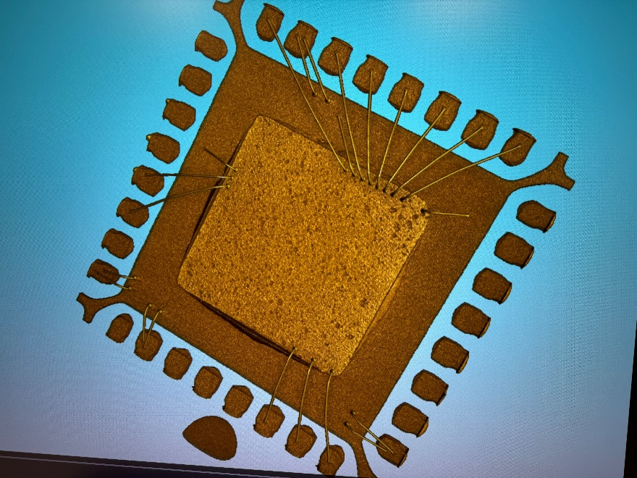
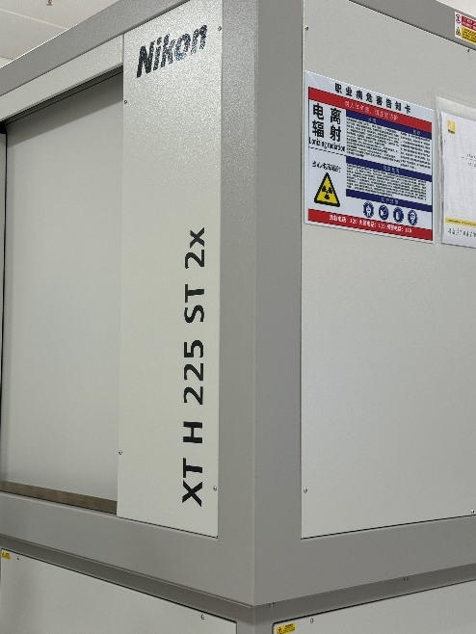
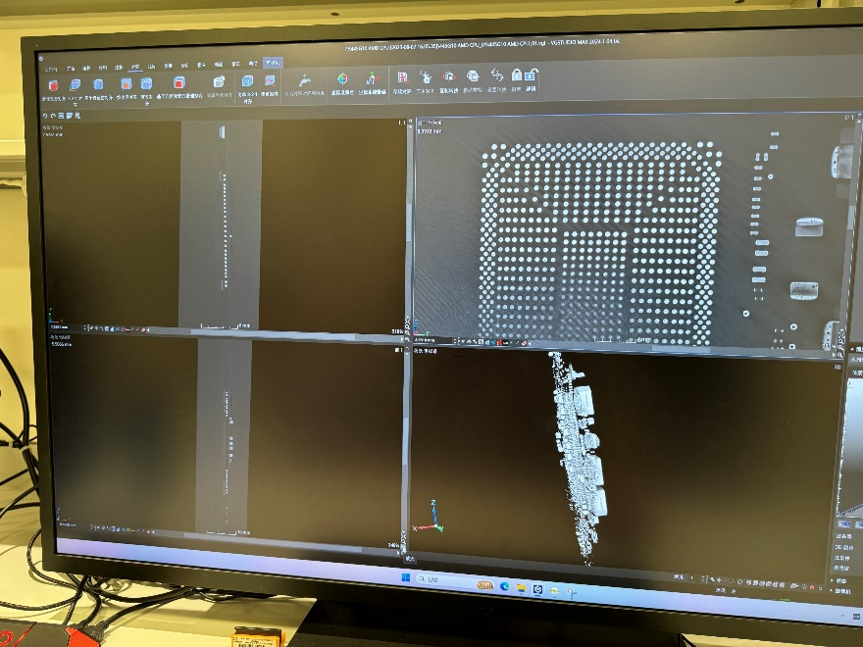
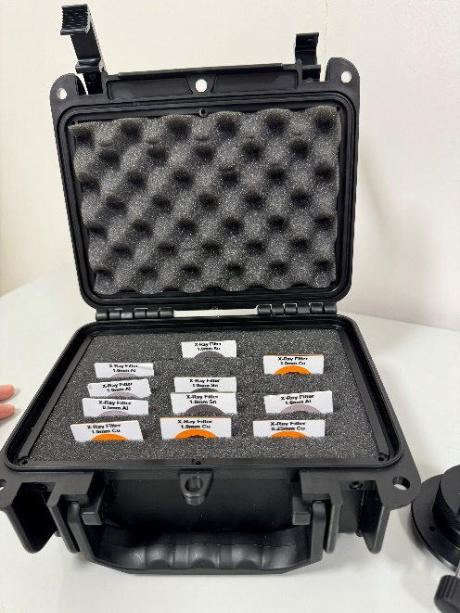
Back Up – Images of HP X-ray Machine

